Slide 1
FDA304 Art References.
Task: Find 10 game references.

Slide 2
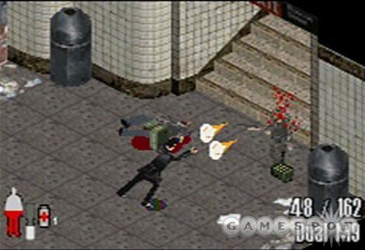
Reference 1: Max Payne (GBA).

